Slide 1

V.L. Sravanthi – 2320090021
T. Sri Ruchitha – 2320090035
M. Madhavi - 2320090020

Slide 2
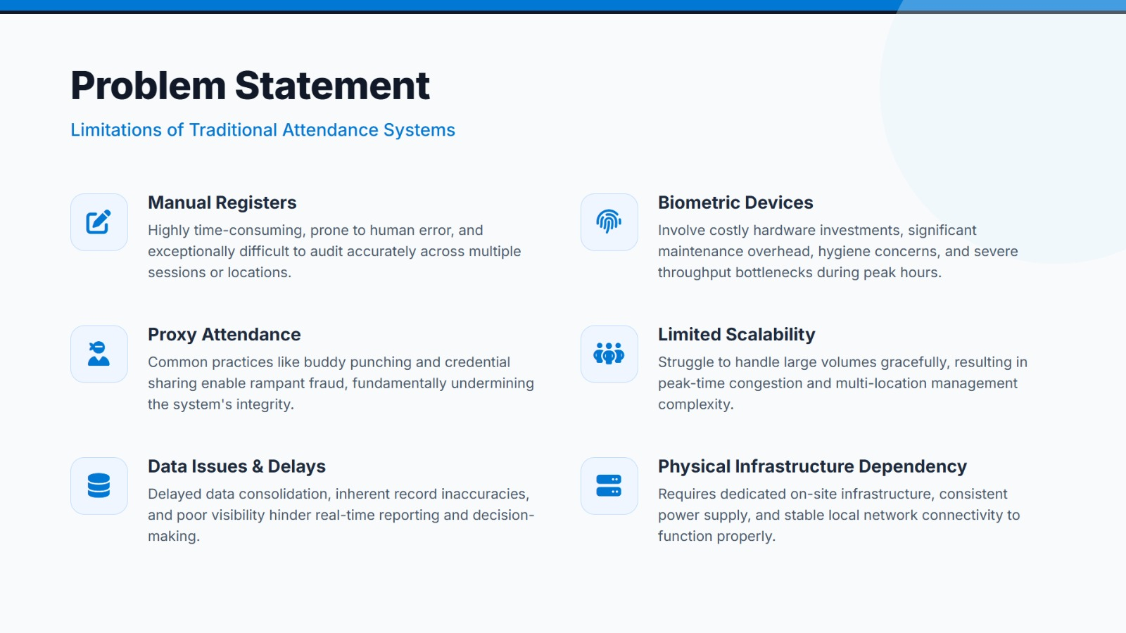

Slide 3


Slide 4


Slide 5
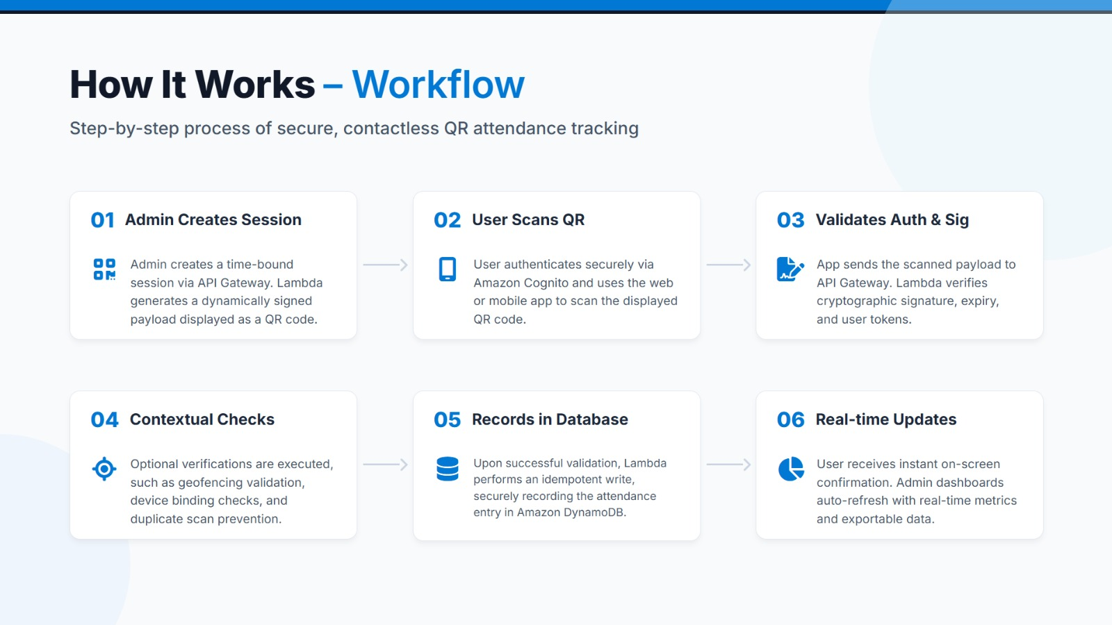

Slide 6
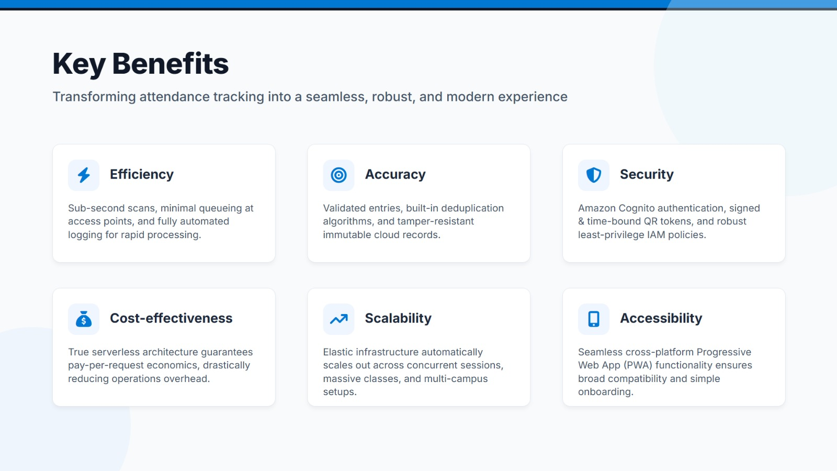

Slide 7
